Slide 1

LLM-FIne Tuned Financial Advisor
Northeastern University
DS5500: Data Science Capstone
P2 Presentation
Team 2
Laasya Anantha Prasad
Krishna Venkatesh
Rakshak Kunchum

Slide 2
Background
Scope : Creating a dynamic, real time personal finance advisory tool to overcome limitations of traditional methods.
Datasets Used : Financial Alpaca Dataset (Stanford Alpaca dataset + the Financial Q&A (FIQA) dataset + GPT 3.5 generated data) and FinTalk-19k Dataset from Hugging Face.
Goal & Outcome: Democratized web app for convenient access and personalized support for credit, budgeting and investments

Slide 3

What is our Project and what has been done?
Gaps in Personal Finance : Traditional tools and financial human experts struggle with modern financial needs and complexity.
LLM based Financial Solution: Real-time insights powered by AI and LLM’s. Access anywhere, efficient and convenient.
Training Features:
Instruction (Question), Context, Response (Answer)

Slide 4
Question answer Pairs: Ideal data for fine tuning Finance LLMs?
Dataset columns | Data type | Description | Data Example
Instruction | String | The question or topic of the conversation. | What can I do to raise my credit score after Discover closed my account due to a fraudulent charge and my score dropped 70 points?
Context | String | Background or additional details about the conversation. | You've had a Discover card for six years without issues. Recently, you noticed three $100 charges from gas stations in a state you’ve never visited. Discover helped you dispute the charges but closed your account, leading to a 70-point drop in your credit score.
Response | String | The answer or information provided in response. | If you believe the fraudulent charge was not your fault, you may be able to dispute the account closure with Discover and have the negative impact on your credit score reversed. You can call Discover's customer service and explain the situation, asking them to reopen the account and issue a new card. Additionally, you can try to rebuild your credit score by applying for a few cards now to avoid taking another average age hit in the future.
Tag | String | Category label for the conversation. | Personal Finance
Text | String/Null | Empty column mostly, hence dropped. | NA

Slide 5
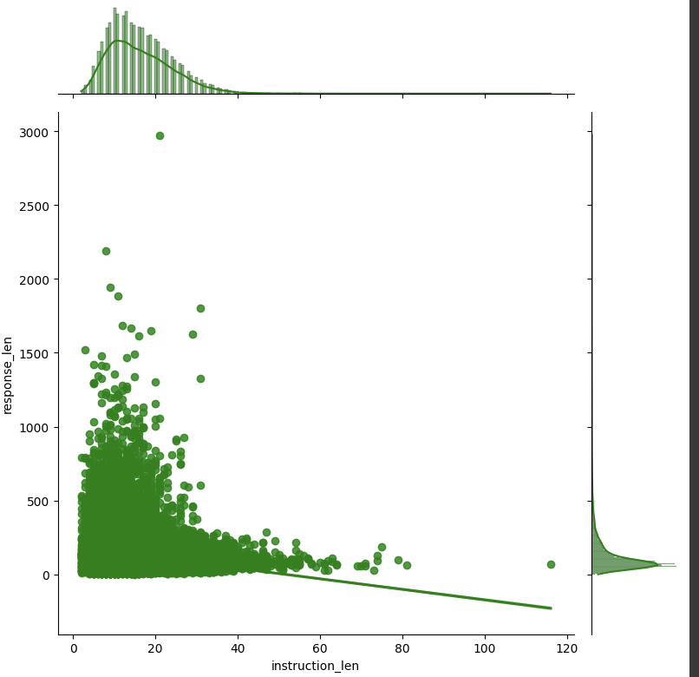
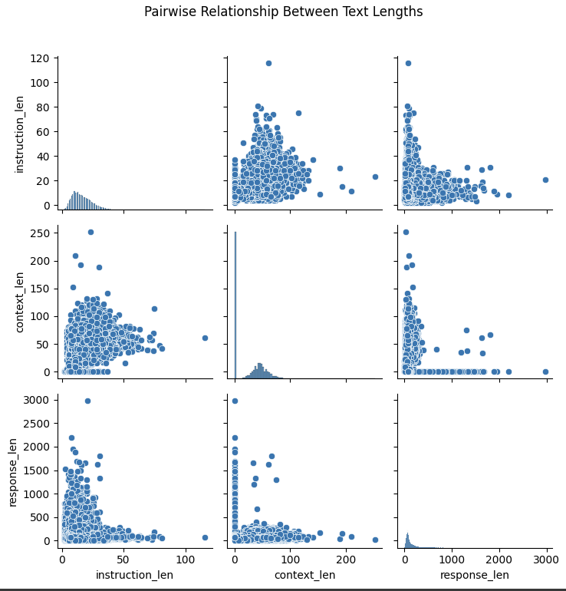
Phase 1 EDA Results - Model Features are not correlated
Longer instruction lengths does not lead to longer response length as shown by pearson correlation value (-0.17) and plot.
Plots indicate that instruction length, context length and response length are slightly or not correlated.

Slide 6
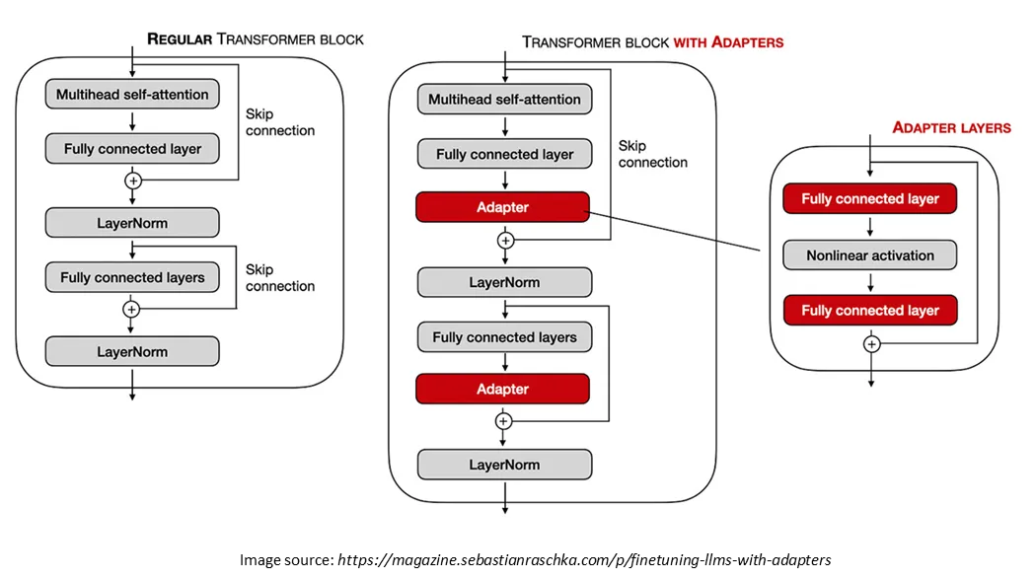
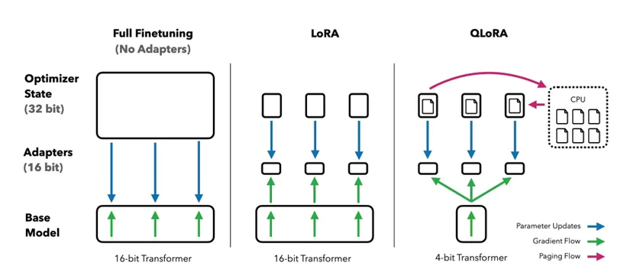
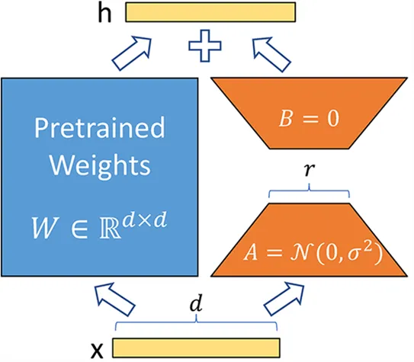
Fine Tuning Training Methodology: Parameter Efficient Fine Tuning
We are using PEFT with QLoRA configuration with 8-bit precision to adaptively fine-tune a causal language model by applying low-rank matrix adaptations on the 'q_proj' and 'v_proj' modules, optimizing memory and computational efficiency for training on limited VRAM.
(QLORA: Efficient Finetuning of Quantized LLMs)

Slide 7
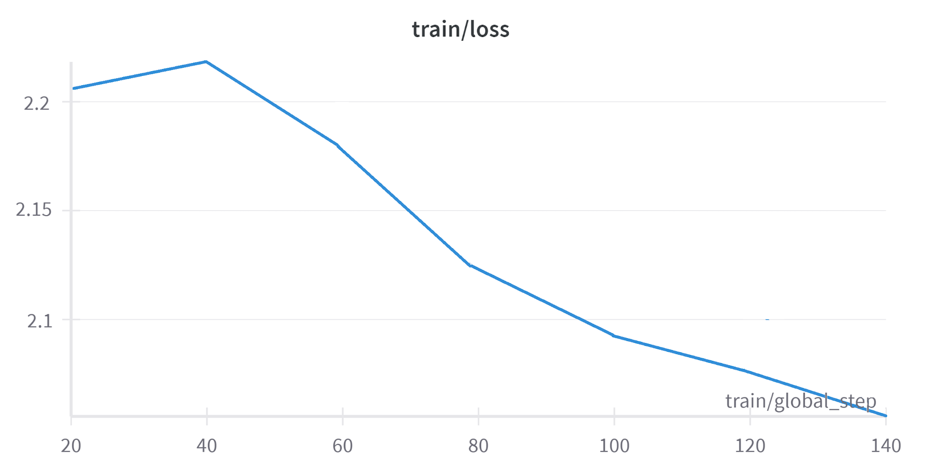
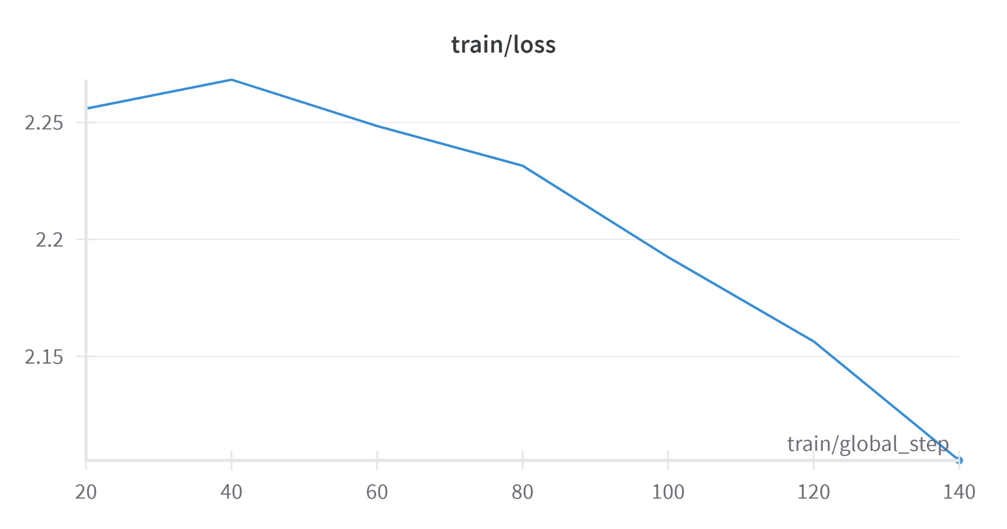
Phase 1 & Phase II Model Training adapt well for financial data
4-6*
SOTA Perplexity Model Scores
7.12
Current Fine tuned LlaMa Perplexity model scores
8.5
Current Fine tuned Mistral Perplexity model scores
LlaMA 7B fine-tuning
Mistral 7B fine-tuning
(* Revolutionizing Financial Insights with Llama-3-70B)
‹#›

Slide 8
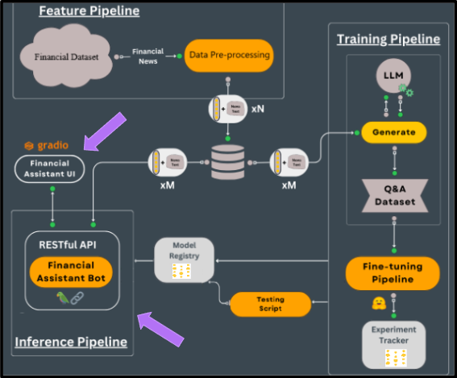
P2 Milestones
Feature Pipeline: (Phase 1)
Processes financial datasets and news for generating structured data inputs for downstream tasks.
Training Pipeline & Model Fine-tuning: (Phase 1 & Phase 2)
Fine-tunes LLaMA and Mistral models using a custom Q&A dataset for accurate financial predictions.
Inference Pipeline: (Phase 2)
Model Inference - Generate insights in real-time
API Development and Financial Advisor UI
‹#›
LLMs kit: Build a production-ready real-time financial advisor

Slide 9
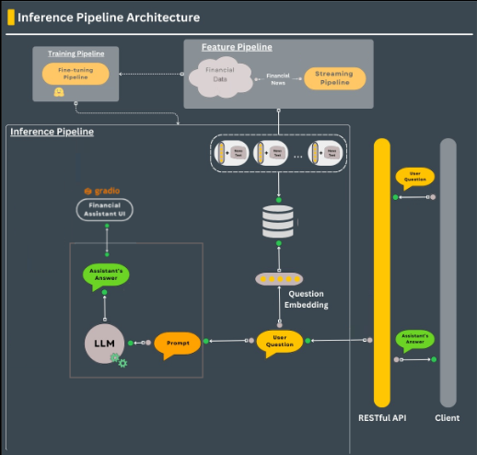
Model Inference pipeline
Inference Pipeline: Transforms user questions into embeddings, utilizes RESTful API to communicate between client and user interface, generates answers using a language model (LLM).
Integration: Connects with a RESTful API to provide seamless interaction between the financial assistant UI and the client.
LLMs kit: Build a production-ready real-time financial advisor
‹#›

Slide 10
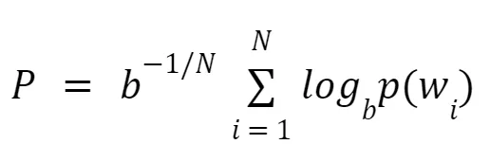
Standard Natural Language Evaluation Metrics are not appropriate for LLM generated Financial advice
Perplexity measures how well a language model predicts word sequences. Lower perplexity indicates better fluency and natural language alignment.
Challenge with ROUGE Evaluation:
The dataset includes advice from authorized financial experts on Reddit, which often includes conversational elements. A direct ROUGE score comparison between dataset responses and model-generated responses may not be appropriate due to the conversational nature of the advice.
Perplexity
Custom Heuristics Evaluation:
Clarity ensures comprehensibility,
Specificity promotes precision in advice,
Relevance validates the contextual alignment of responses.
‹#›

Slide 11



Custom Heuristics Provide better evaluation for language models for financial advice
 | Clarity | Specificity | Relevance
Goal | Ensures the financial advice is clear and easy to understand. | Evaluates how specific and detailed the advice is. | Ensures the advice aligns with the user's intent and the original financial query.
Approach | Compares the length of the ground truth and model-generated responses as a proxy for simplicity. | Counts the presence of financial terms in the response. | Measures semantic similarity between the ground truth and the response.
Method | Measures the absolute difference in word count between the ground truth and the response. A smaller difference indicates clearer communication, assuming overly complex or overly brief responses may reduce clarity. | Matches model-generated terms with a predefined list of financial keywords (e.g., "interest rate," "investment"). The score is based on the proportion of keywords in the model response relative to the ground truth, promoting precise and actionable advice. | Uses cosine similarity, leveraging TF-IDF vectorization to calculate the alignment of text. A higher similarity score indicates better alignment and contextual relevance.
Formula

Slide 12
Case by case analysis of custom heuristic evaluation metrics
Instruction | Context | Dataset Response | Fine-Tuned Model Response
How do I find a good mutual fund to invest 5K in with a moderately high amount of risk? | NA | Vanguard has a lot of mutual fund offerings. (I have an account there.) Within the members' section they give indications of the level of risk/reward for each fund. | The best way for you to invest $5000 is to take advantage of your employer's retirement plan, which will allow you to set aside money tax-free and automatically have it invested into funds based on your age and goals. If your company does not offer this benefit, then you should look at Vanguard (VG) or Fidelity (FD). These are two large discount brokerage firms that have low fees and offer great diversification by owning a variety of stocks and bonds rather than just one or two mutual funds. Both companies provide online tools where you can create an account and start investing immediately. Good luck!
ROUGE-L Score | Clarity Evaluation | Specificity Evaluation | Relevance Evaluation
0.139 | 0.0 | 0.5 | 0.129
Clarity is direct comparison of the model response length and dataset response length. Although the model response is good, the difference in length is large due to lack of context, hence the clarity scores 0.
As specificity and relevance do not depend on response length, they are better suited for evaluating LLM responses without context.
‹#›

Slide 13
Case by case analysis of custom heuristic evaluation metrics
Instruction | Context | Dataset Response | Fine-Tuned Model Response
What are your thoughts on using pay later and payday lenders, and do you think they are out of control? | The writer is walking to the train station and notices multiple ads for pay later and payday lenders, which prompts them to express their concerns about the services. | The writer is concerned about the prevalence of pay later and payday lenders and their potential to lead people into debt for discretionary spending. They personally use Zip Pay to spread out their expenses and find it helpful for their mental health, but acknowledge that these services can be risky if not used responsibly. | I feel like pay later and payday lending companies should be heavily regulated as they can take advantage of people in need. In addition, it seems like many borrowers use these services more than once or twice per year, so they could easily end up in debt if they aren't careful. It also makes me nervous how easy it appears to get approved; anyone who has any kind of credit score can probably qualify.
ROUGE-L Score | Clarity Evaluation | Specificity Evaluation | Relevance Evaluation
0.189 | 0.62 | 0.667 | 0.193
In this example, the context is present. The model response length is similar to the dataset response length and the clarity score is also good.
With context, specificity and relevance also show a slight increase.
‹#›

Slide 14
Fined tuned Models are generating clear and succinct financial advice with context when compared to baseline models
Instruction | Context | Baseline Response | Fine Tuned Llama Response | Fine Tuned Mistral Response
When should I get a second credit card? | Seeking advice on managing credit cards and considering when to apply for a second one. | The optimal time to consider getting a second credit card is when you have fully managed your existing credit | You can apply for your first credit card when you are 18 years old and have a steady income, such as from employment or investments. You may also be able to qualify if you're married or live with someone who has a good credit history. If you don’t meet these requirements yet, it might make sense to wait until you do before applying for another credit card. | In general, you should only get one or two credit cards at a time, and only if you can pay the bill in full each month. If you get several credit cards in a short period of time, you may not have enough available credit to keep your credit utilization ratio low, which could hurt your credit scores.
Tell me about the risks in money market accounts? | Exploring financial instruments and understanding potential risks associated with money market accounts. | Money market accounts carry risks such as interest rate fluctuations affecting yields, and potential penalties on frequent withdrawals. | Money Market Accounts are considered to be one of the safest investments available today, but they do have some risk factors associated with them. The first and most important thing you need to know when it comes to MMA is that there is no guarantee on your principal amount invested. Another risk factor is liquidity. | Money market accounts are vulnerable to interest rate volatility, which can alter returns, and face potential credit risks in the securities they invest in, alongside regulatory withdrawal limitations.
‹#›

Slide 15
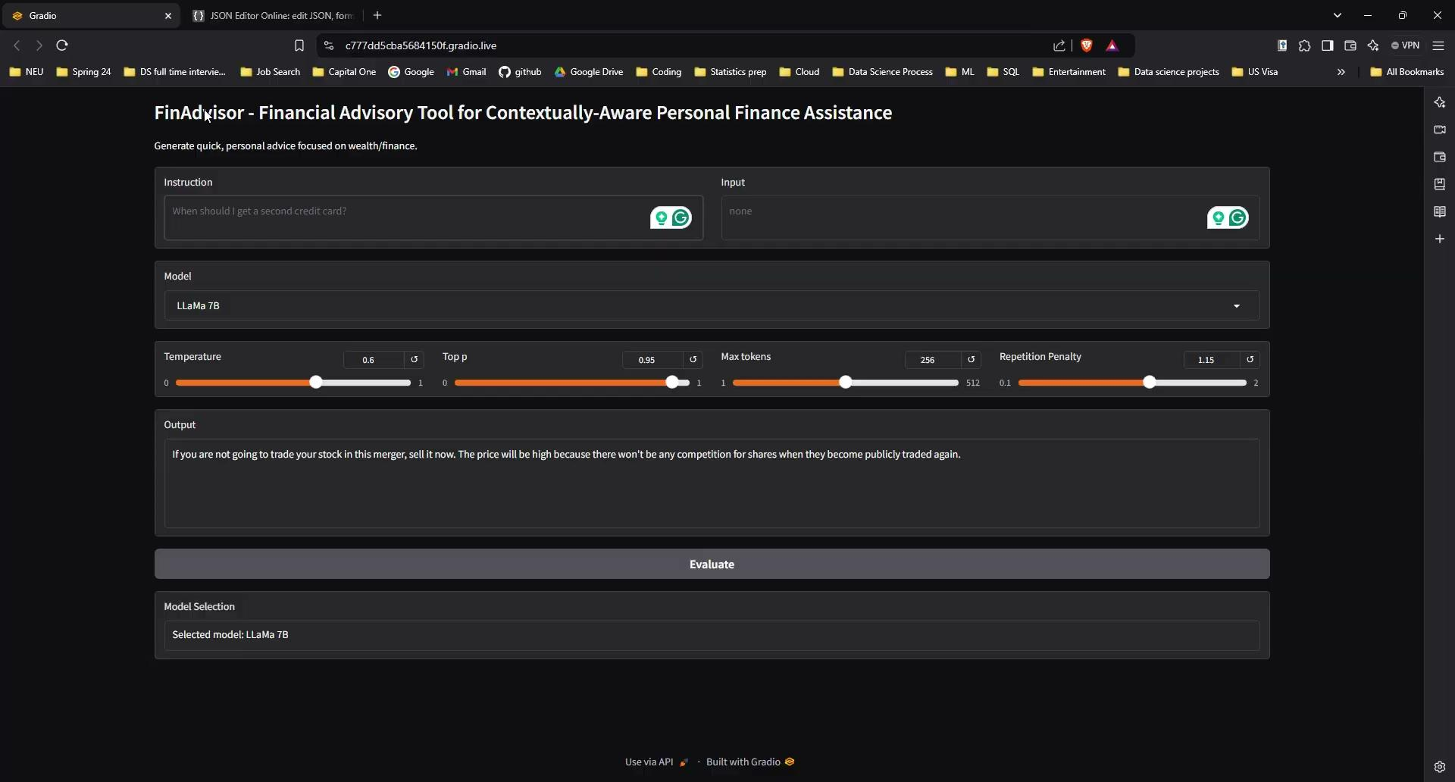
Gradio User interface Demo

Slide 16

Conclusion
From the many examples and evaluation metrics that we have explored, we can see that FinAdvisor generates quick and comprehensive responses for personal finance prompts, with and without context.
LLM models can now understand meaning and sentiment in a human-like way.
We are close to achieving Artificial General intelligence (AGI) (What a time to be alive!)
Thank you for exploring this exciting innovation with us!

Slide 17
Questions?
ThanK YoU

